Slide 1



UN Systems Projects report
View in Power BI
Last data refresh:
7/2/2026 9:38:37 AM UTC
Downloaded at:
7/2/2026 9:44:27 AM UTC

Slide 2
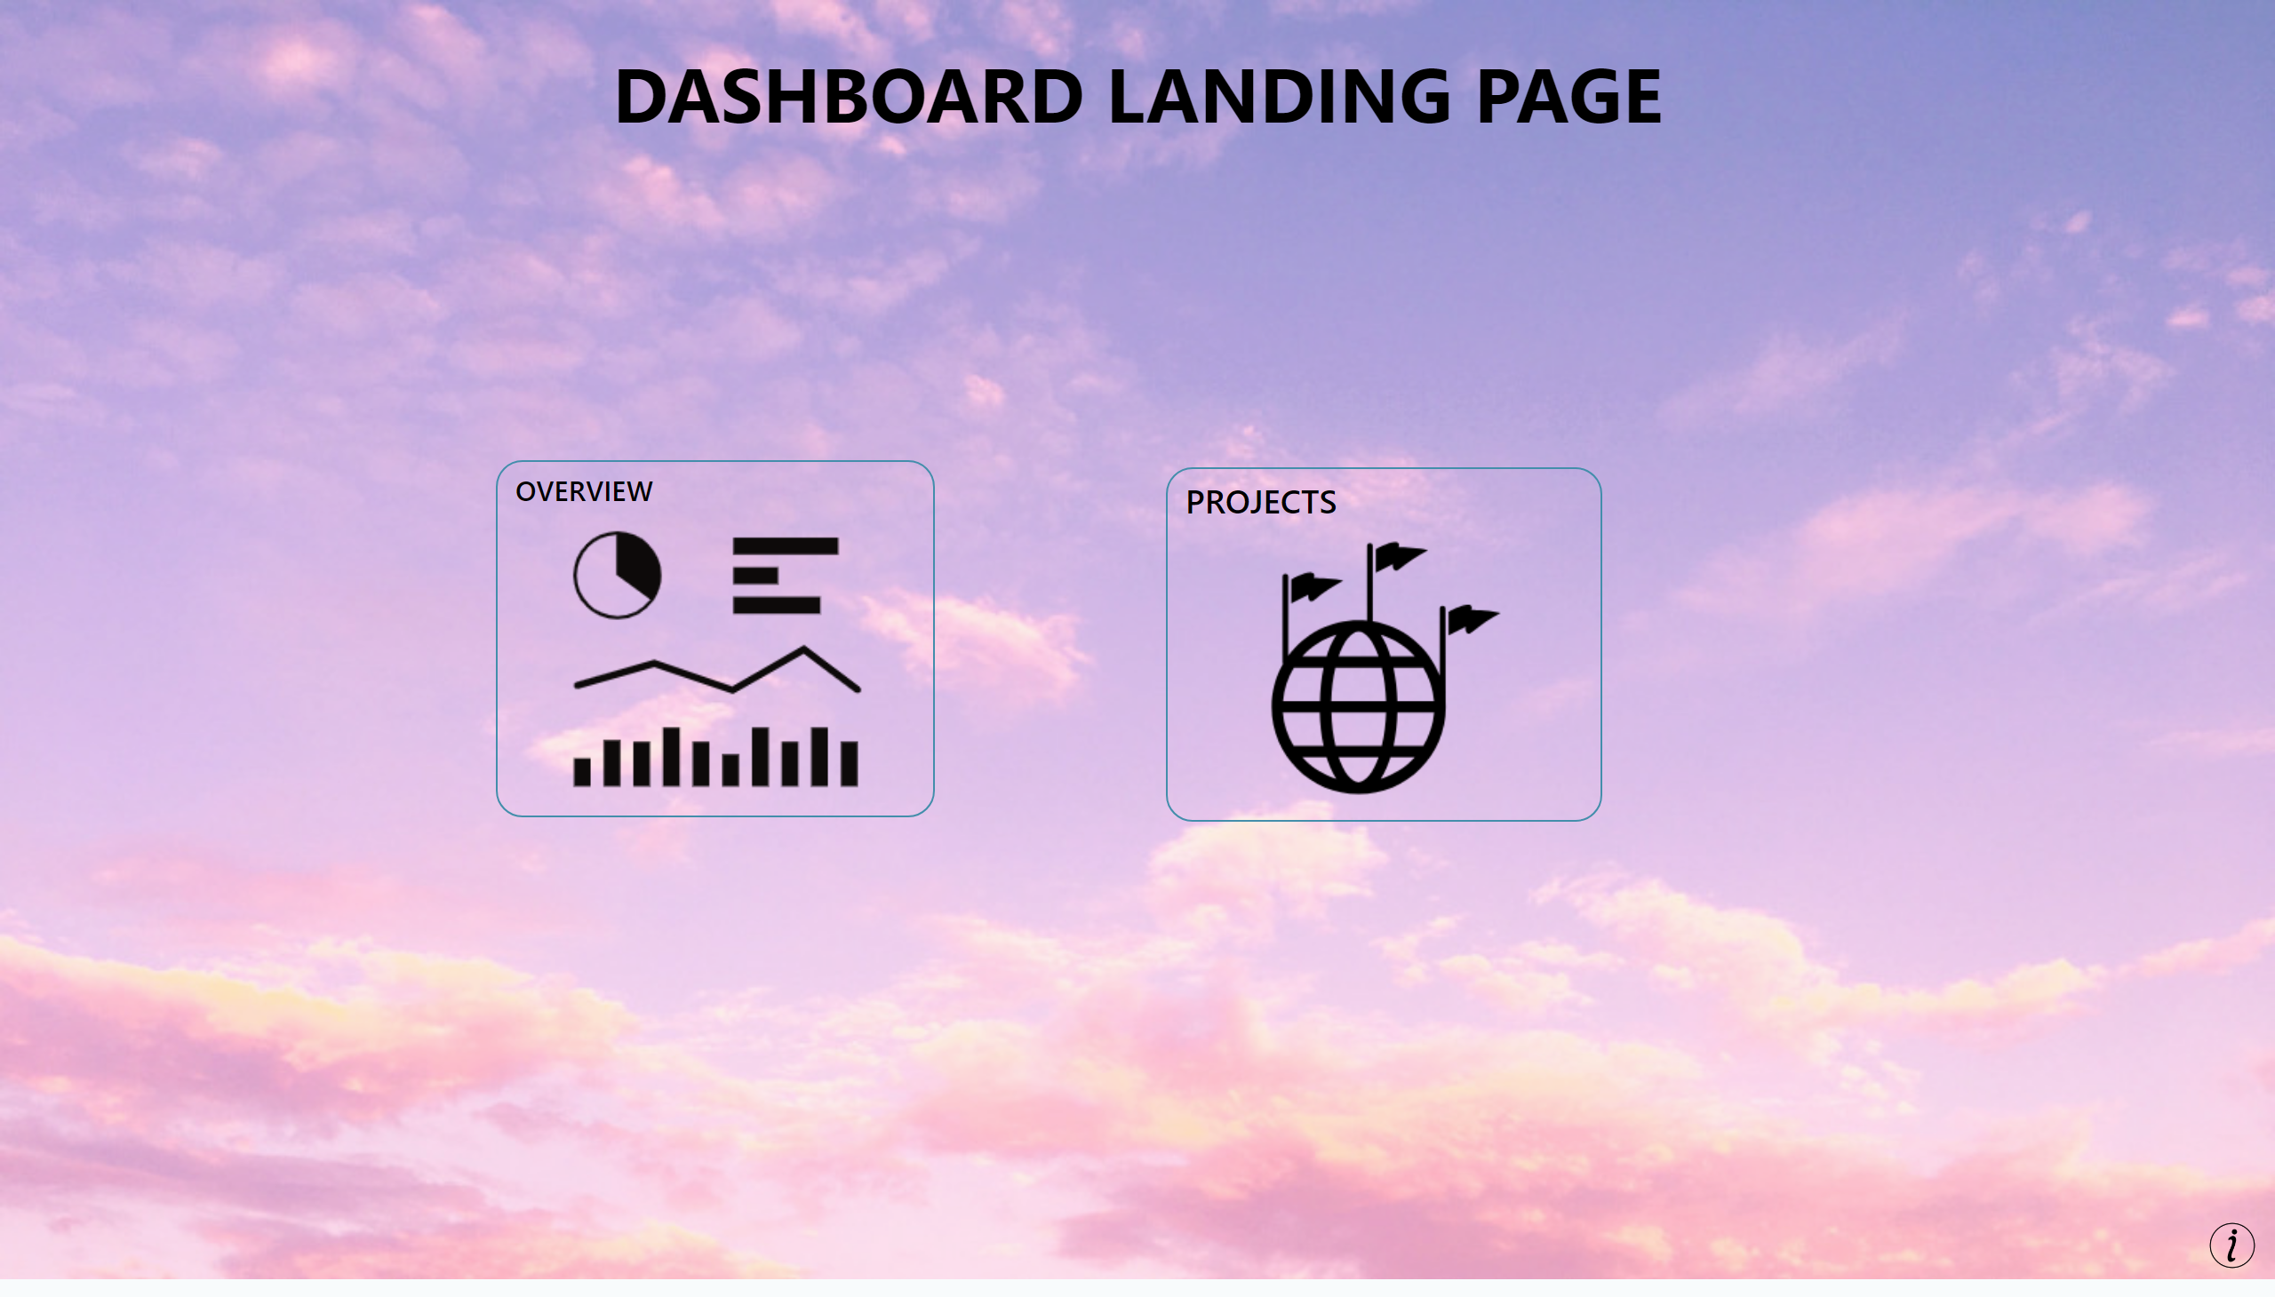
Homepage
Notes:
PROJECTS
No alt text provided
textbox
No alt text provided
image
No alt text provided
image
No alt text provided
image
No alt text provided
OVERVIEW
No alt text provided

Slide 3
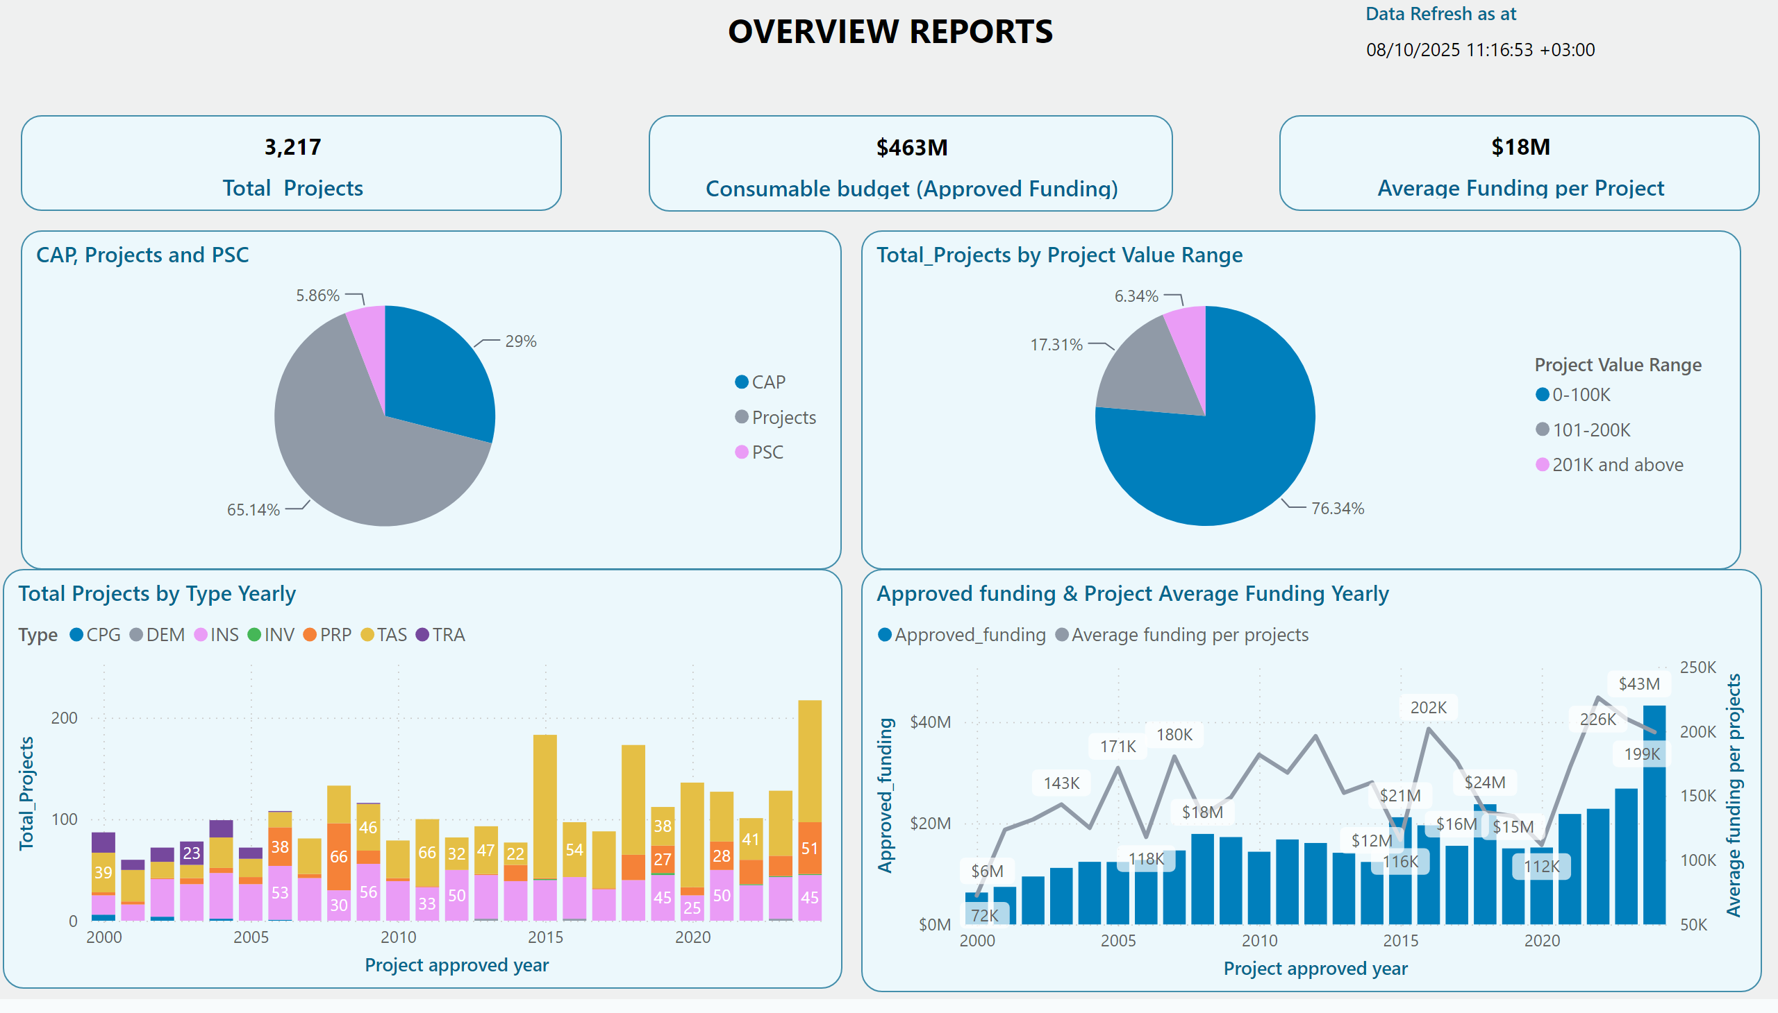
Overview
Notes:
image
No alt text provided
image
No alt text provided
image
No alt text provided
image
No alt text provided
image
No alt text provided
image
No alt text provided
image
No alt text provided
textbox
No alt text provided
Data Refresh as at
No alt text provided
slicer
No alt text provided
slicer
No alt text provided
slicer
No alt text provided
slicer
No alt text provided
shape
No alt text provided
shape
No alt text provided
image
No alt text provided
pieChart
No alt text provided
Approved funding & Project Average Funding Yearly
No alt text provided
pieChart
No alt text provided
Total Projects by Type Yearly
No alt text provided
card
No alt text provided
card
No alt text provided
card
No alt text provided
slicer
No alt text provided
slicer
No alt text provided
slicer
No alt text provided
shape
No alt text provided
slicer
No alt text provided
slicer
No alt text provided
shape
No alt text provided
image
No alt text provided

Slide 4
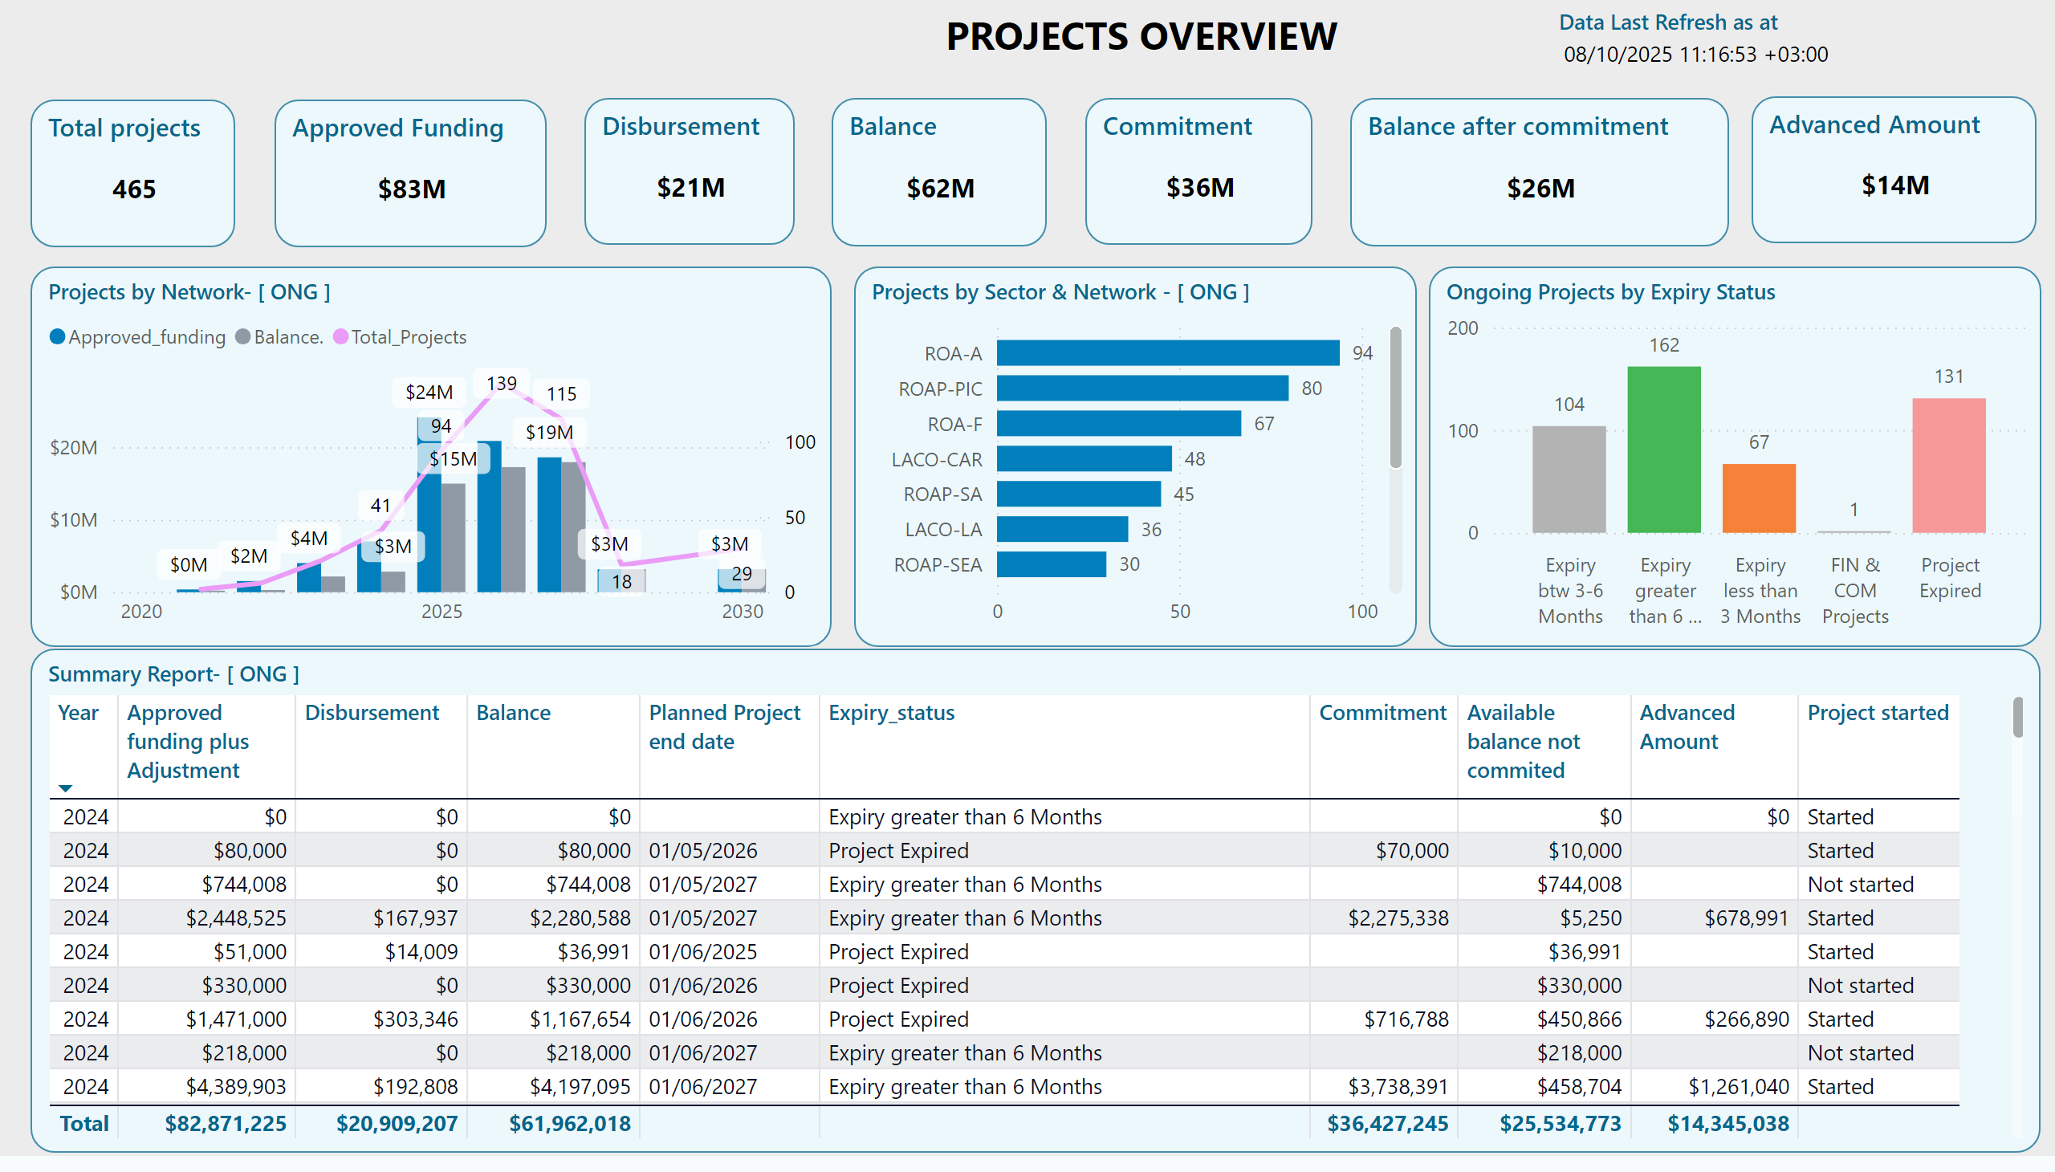
Projects report
Notes:
Summary Report- [ ONG ]
No alt text provided
Projects by Network- [ ONG ]
No alt text provided
Projects by Sector & Network - [ ONG ]
No alt text provided
Ongoing Projects by Expiry Status
No alt text provided
slicer
No alt text provided
slicer
No alt text provided
slicer
No alt text provided
slicer
No alt text provided
slicer
No alt text provided
shape
No alt text provided
slicer
No alt text provided
slicer
No alt text provided
slicer
No alt text provided
slicer
No alt text provided
shape
No alt text provided
textbox
No alt text provided
Balance
No alt text provided
Advanced Amount
No alt text provided
Balance after commitment
No alt text provided
Disbursement
No alt text provided
Commitment
No alt text provided
Approved Funding
No alt text provided
Total projects
Total count of all Projects
Data Last Refresh as at
No alt text provided
image
No alt text provided
textbox
No alt text provided
image
No alt text provided
textbox
No alt text provided
image
No alt text provided
image
No alt text provided
image
No alt text provided
image
No alt text provided
image
No alt text provided
image
No alt text provided
image
No alt text provided
image
No alt text provided
actionButton
No alt text provided
actionButton
No alt text provided
actionButton
No alt text provided
actionButton
No alt text provided
actionButton
No alt text provided
image
No alt text provided

